Slide 1

Linux Basics
Notes:
Tux source: http://upload.wikimedia.org/wikipedia/commons/thumb/a/af/Tux.png/220px-Tux.png

Slide 2
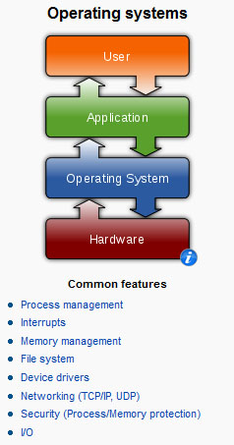
What is Linux?
-> It’s an OS
Notes:
Operating systems graphic source: http://en.wikipedia.org/wiki/Operating_system

Slide 3
Linux/Unix?
Linux is a Unix clone written from scratch by Linus Torvalds (with the help of others), initially launched in 1991
Unix is a multitasking, multi-user computer operating system originally developed in 1969 by a group of AT&T employees at Bell Labs.
99.4% of Top500 Super Computers use Linux
Notes:
What is Linux? source: http://www.kernel.org/pub/linux/kernel/README and http://en.wikipedia.org/wiki/Linux and http://en.wikipedia.org/wiki/Unix
POSIX an acronym for "Portable Operating System Interface", is a family of standards specified by the IEEE for maintaining compatibility between operating systems. POSIX defines the application programming interface (API), along with command line shells and utility interfaces, for software compatibility with variants of Unix and other operating systems (source: http://en.wikipedia.org/wiki/POSIX).

Slide 4

Linux has many distributions (distro’s, variants, flavours)
Notes:
Logos source: http://www.muylinux.com/wp-content/uploads/2009/04/logos-distros.jpg

Slide 5
Linux Structure

Slide 6
The Shell
A shell is a computer program that interprets the commands you type and sends them to the operating system. Secondly, it provide a programming environment consisting of environment variables.
BASH/TCSH/others
To determine your shell type:
echo $SHELL (shell prints contents of env
System info:
uname -a

Slide 7
Your first Linux commands
Type: whoami
Get help for any command:
whoami –-help
man whoami
You can also Google it! ☺
Notes:
Life preserver image source: http://ubesicecreamshop.com/wp-content/uploads/2012/04/life-preserver.jpg

Slide 8
The Basics
Network: ssh, scp, ping, telnet, traceroute, wget
Shells: BASH, TCSH, alias, watch, clear, history, echo, setenv
Process Management: ps, top, kill, killall, fg, bg
System Information: w, whoami, man, info, which, free, echo, date, cal, df, free, man, info
Command Information: man, info
Symbols: |, >, >>, <, &, >&, 2>&1, ;, ~, ., .., $!, !:<n>, !<n>
Filters: grep, egrep, more, less, head, tail
Hotkeys: <ctrl><c>, <ctrl><d>
File System: ls, mkdir, cd, pwd, mv, ln, touch, cat, find, cmp, /net/<hostname>/<path>, du, df, chmod, find
Line Editors: awk, sed
File Editors: vim, nano, emas

Slide 9
pwd & List (ls)
Useful options for the “ls” command:
ls -a List all file including hidden file beginning with a period “.”
ls -F Put an indicator character at the end of each name
ls –l Simple long listing
ls –lh Give human readable file sizes
ls –lS Sort files by file size
ls –lt Sort files by modification time

Slide 10
cd, mkdir, cp, rm, mv, echo
cd (also takes you to your home directory like cd ~)
mkdir test
echo ‘Hello world’
touch / nano myfile.txt
echo ‘Hello everyone’ > test/myfile.txt
>> - append (adauga la final)
mkdir -p test/subdir1/subdir2
mv test/myfile.txt test/subdir1/subdir2
cp (copiere) – Sintaxa: cp what_to_copy where_to_copy
mv (move) – Sintaxa: mv what_to_move where_to_move
rm (remove). Sintaxa: rm file sau rm –r folder/

Slide 11
Install packages/tools
apt-cache search package_name (search in repo)
apt-get install package_name (install)
apt-get remove (remove)
apt-get update !!! (update the details about the packages [new versions], sources list, etc)

Slide 12
File System Ownership and Permissions
All files and directories have a individual and a group ownership.
All files and directories have read (r - 4), write (w - 2), and execute (x - 1) permissions assigned as octets to the individual owner (u), the group (g) owner and all others (o) that are logged into the system.
You can change permissions if you are the individual owner or a member of the group.
Only root (including sudoers) can change ownership
http://chmod-calculator.com/

Slide 13
File and Directory Ownership and Permissions
Let’s try changing permissions
cd
touch myfile (create file)
mkdir mydir (create directory)
chmod g+w myfile (add group write permission)
-> equivalent to chmod 020 myfile
ls –l myfile
chmod ugougo+x myfile (add user, group and other execute permission)
-> equivalent to chmod 111 myfile
chmod ugo+w mydir (add user, group and other write permission)
ls –ld mydir
chmod a-w (a=ALL, remove user, group and other write permission)

Slide 14
Changing ownership
chown user:group fisier (schimbarea ownerului unui fisier)
chown user:group folder/ (schimbarea ownerului tuturor fisierelor din folderol folder/– parametrul –R = recursive)

Slide 15
df & du
df –h (all the partitions that are mounted)
df –hT (display T=partition type too)
du –h (display info about used disk space in current directory)
du –sh (summary)

Slide 16
Symbolic links (ln)
A link can be created in order to facilitate the access of a file/folder
ln -s /path_to_the_file link_name
Example:
ln -s /home/ubuntu/demo5/demo mydemofile
Now if you do the command ll you will see the link and where it points to:
lrwxrwxrwx 1 ubuntu ubuntu 23 May 15 13:11 mydemofile -> /home/ubuntu/demo5/demo

Slide 17
Arhivare
Arhivarea este procedeul prin care mai multe fişiere şi directoare sunt adunate la un loc (într-un fişier)
gzip, mai rapid dar cu rată de compresie mai mică; (-x)
bzip2, mai lent dar cu rată de compresie mai mare. (-j)
mkdir demo
cd demo/
wget atos-linux.info.tm/demo && wget atos-linux.info.tm/demo2
tar –cxvf demo.tar.gz demo/
rm –r demo/
tar –xzvf demo.tar.gz

Slide 18
head, tail, sort, grep
Comanda head este folosită pentru a afişa primele linii dintr-un fişier.
head –n 2 demo
Comanda tail este folosită pentru a afişa ultimele linii dintr-un fişier
tail –n 1 demo
Comanda sort este folosită pentru a afişa în ordine sortată liniile unui fişier sau datele primite ca argument
sort demo
sort –r demo
sort –n demo2
Comanda grep este folosita pentru a face “search” bazat pe un keyword (sau keywords daca foloseste regex)

Slide 19
Find
Comanda find foloseşte aboradrea brute-force pentru găsirea fişierelor căutând în arborele de directoare. Comanda pune la dispoziţie un set extins de criterii de căutare, cum ar fi numele fişierului, utilizatorul, grup, tip, permisiuni, dată şi altele
Azi o sa folosim 3 exemple:
- name (cautare dupa numele fisierului)
- size (cautare dupa dimensiune)
- user (cautare dupa owner)
- perm (cautare dupa permisiuni)
find /etc -name issue
find /etc -size +30k
find /… -user userul_vostru
find /etc –perm 777
find / –name nume_fisier (cautare in tot sistemul!)
Comanda locate foloseşte o bază de date locală în care sunt indexate toate fişierele. Comanda locate este mai rapidă decât comanda find, dar pune la dispoziţie un singur criteriu de căutare: numele fişierului. Un alt dezavantaj este faptul că baza de date trebuie reactualizată periodic pentru a conţine informaţii despre fişierele noi create în sistem. Actualizarea se realizează cu ajutorul comenzii updatedb.

Slide 20
Procese
Procesul sta la baza oricarei activitati in Linux. La lansare in executie a unei comenzi sau a unei applicatii se creeaza un proces. Controlul proceselor este realizat prin cateva apeluri (semnale / call-uri) care sunt functii inglobate in nucleu, accesibile utilizatorilor
In Linux, fiecare proces are un numar UNIC de identificare asociat (PID – process id). PID-ul este un numar intreg, pozitiv, care poate fi reatribuit dupa terminarea procesului care-l detine.
Comanda ps afiseaza procesele care ruleaza in system
Ea poate sa vina cu anumite optiuni:
- a – afiseaza toate procesele care ruleaza in system, nu doar cele rulate de utilizatorul current
- u – afiseaza numele utilizatorului care controleaza procesul
- x - afiseaza toate procesele rulate de utilizatorul current
Exemplu: ps aux sau top pt realtime

Slide 21
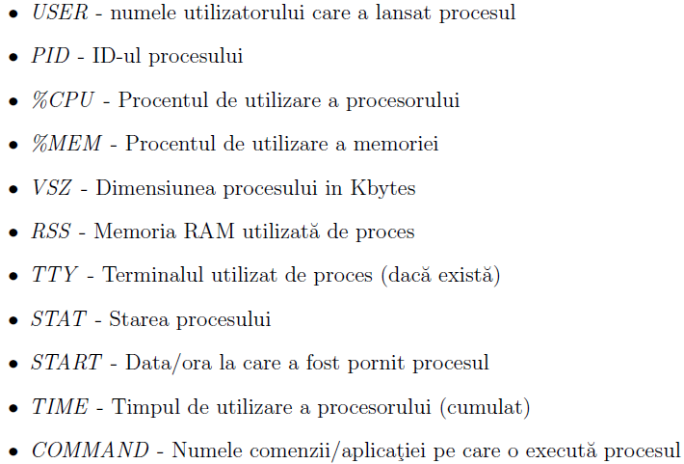
ps aux

Slide 22
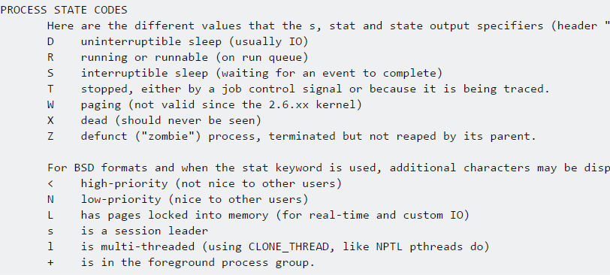
State codes

Slide 23
Process tree
pstree afiseaza arborescent procesele care ruleaza in system
Optiuni
-p – afiseaza numele si PID-ul
-n – ordoneaza dupa PID procesele care au acelasi proces parinte (alfabetic)

Slide 24
Kill
Kill este un semnal care poate fi trimis unui proces cu diverse scopuri
Optiunea –l afiseaza lista semnalelor ce pot fi trimise catre un process
kill -9 PID_process (force kill)
kill –HUP PID_PROCESS (refresh)

Slide 25
crontab
Acest program adună informaţii despre programe şi despre momentele în care acestea sunt programate să ruleze, folosind intrările din fişierul crontab, generate de sistem sau de catre utilizatori.
Se poate accesa/edita folosind comanda crontab -e
Fiecare linie din crontab trebuie sa aiba 6 campuri (separate prin spatiu). Primele 5 sunt numere intregi dupa cum urmeaza:
1. minute (0-59)
2. hour (0-23)
3. day of the month (1-31)
4. month of the year (1-12)
5. day of the week (0-6 with 0=Sunday).
Note: Each of these patterns may be either an asterisk ( * - meaning all valid values) or a list of elements separated by commas.

Slide 26
crontab (exemple) Format: minut ora zi luna zi-a-saptamanii comanda_de_executat
0 0 1,15 * 1 /home/myhomedir/myscript.sh
- ruleaza scriptul myscript.sh la ora 00:00 in prima zi a lunii, in data de 15 a lunii, precum si in fiecare prima zi a saptamanii (Luni)
30 16 * * 5 service apache2 restart
restart al serviciului de Apache2 in fiecare 5-a zi a saptamanii (Vineri), la ora 16:30
15 21 1,15,30 1,6 * ping 8.8.8.8 > ping_result.txt
in zilele de 1, 15 si 30 a lunilor 1 si 6 (Ianuarie si Iunie), la ora 21:15 se va rula comanda de ping catre 8.8.8.8 iar outputul comenzii (rezultatul) va fi stocat in fisierul ping_result.txt
crontab –l to display all cronjobs

Slide 27
init.d
Most Linux distributions includes scripts in /etc/init.d directory, which are started during the boot process (or executed when you shutdown or reboot the system).

Slide 28
netstat & md5sum
netstat – network utility tool prin care se pot vedea anumite informatii ce tin de networkingul unui system (conexiunile existente, porturi deschise, routing table, etc)
netstat are mai multi parametrii disponibili (netstat –-help)
netstat –antup
md5sum – tool pentru verificarea integritatii si a autenticitatii unui fisier (original / valid hash needed)
md5sum fisier
md5sum –c hash_locations

Slide 29
Bash
Bourne Again Shell is the GNU Project’s shell.
Incorporeaza “tool-uri” utile din ksh si C shell (sh)
Un script shell este un fisier executabil care contine comenzi de baza sau comenzi specific shell-urilor
Exemple:

